Slide 1


Analyzing Social Buzz’s Content

Slide 2


Today's agenda
Project recap
Problem
The Analytics team
Process
Insights
Summary

Slide 3

Social Buzz is a fast growing technology unicorn that need to adapt quickly to it’s global scale.
Accenture has begun a 3 month POC focusing on three tasks:
An audit of Social Buzz’s big data practice
Recommendations for a successful IPO
Analysis to find Social Buzz’s top 5 most popular categories of content
Project Recap

Slide 4

Problem
Over 100000 posts per day
36,500,000 pieces of content per year!
But how to capitalize on it when there is so much?
Analysis to find Social Buzz’s top 5 most popular categories of content

Slide 5



Andrew Fleming
Chief Technical Architect
The Analytics team
Marcus Rompton
Senior Principle
Ary Widanthi
Data Analyst

Slide 6
Process
1
Data Understanding
2
Data Cleaning
3
Data Modeling
4
Data Analysis
5
Uncover Insights

Slide 7

Insights
16 unique content categories
Top popular category is Animals with 21.4% score.
Each content category has a unique approach to how content is delivered.

Slide 8
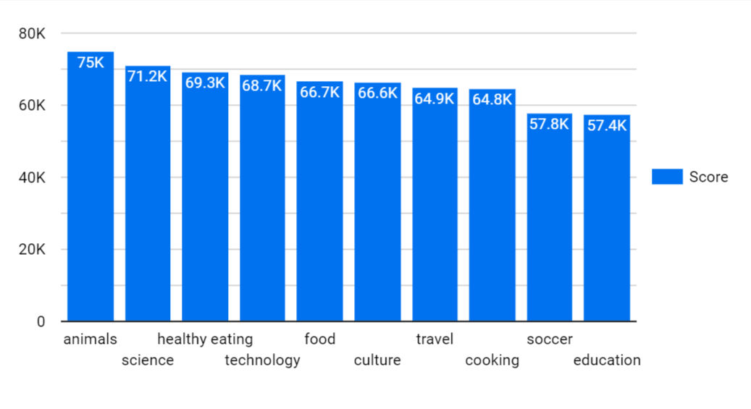
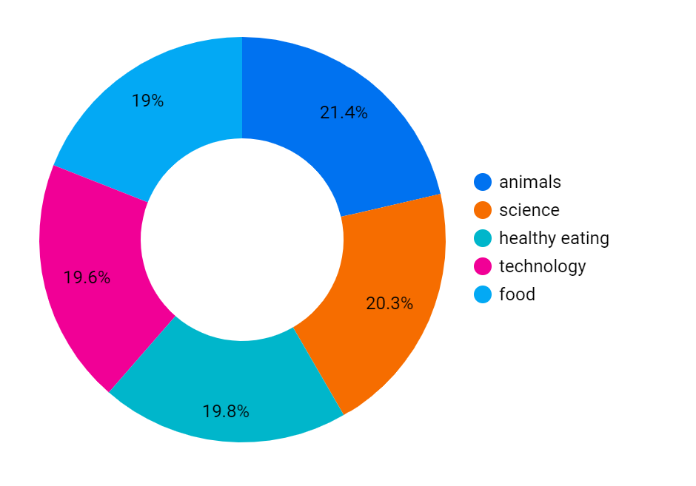
The top five content categories are animals, science, healthy eating, technology, and food.
The highest score is animals category with 21.4% score.

Slide 9
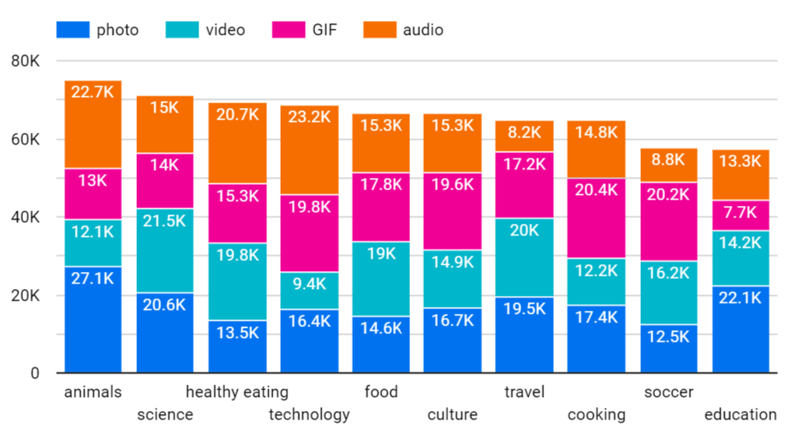
Each category has a distinct approach to determining which content type performs best. For example, if the content type is video, the science content category will get a high score.

Slide 10
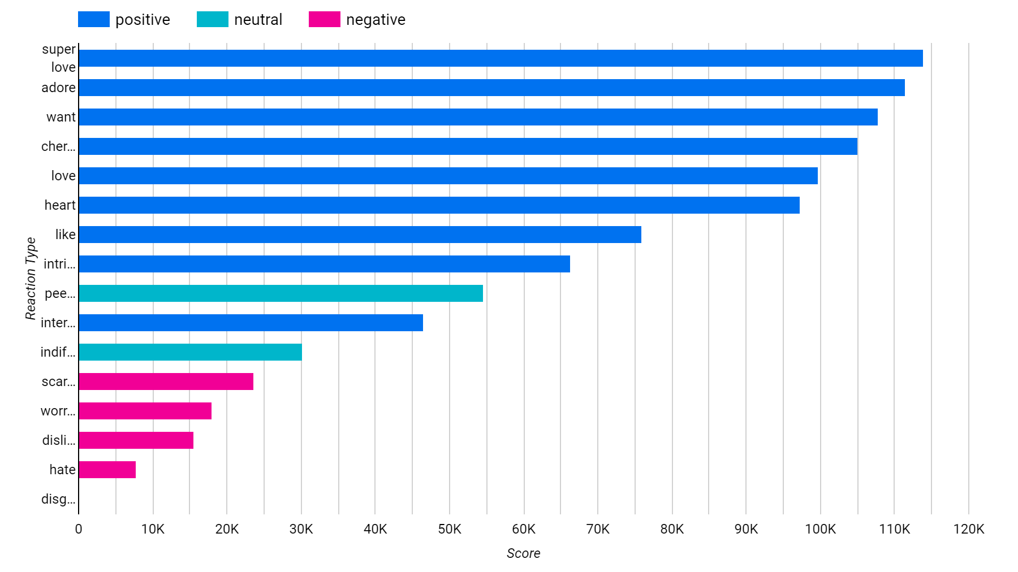
There are three types of sentiment: positive, neutral, and negative. The chart above depicts reaction type categories.

Slide 11
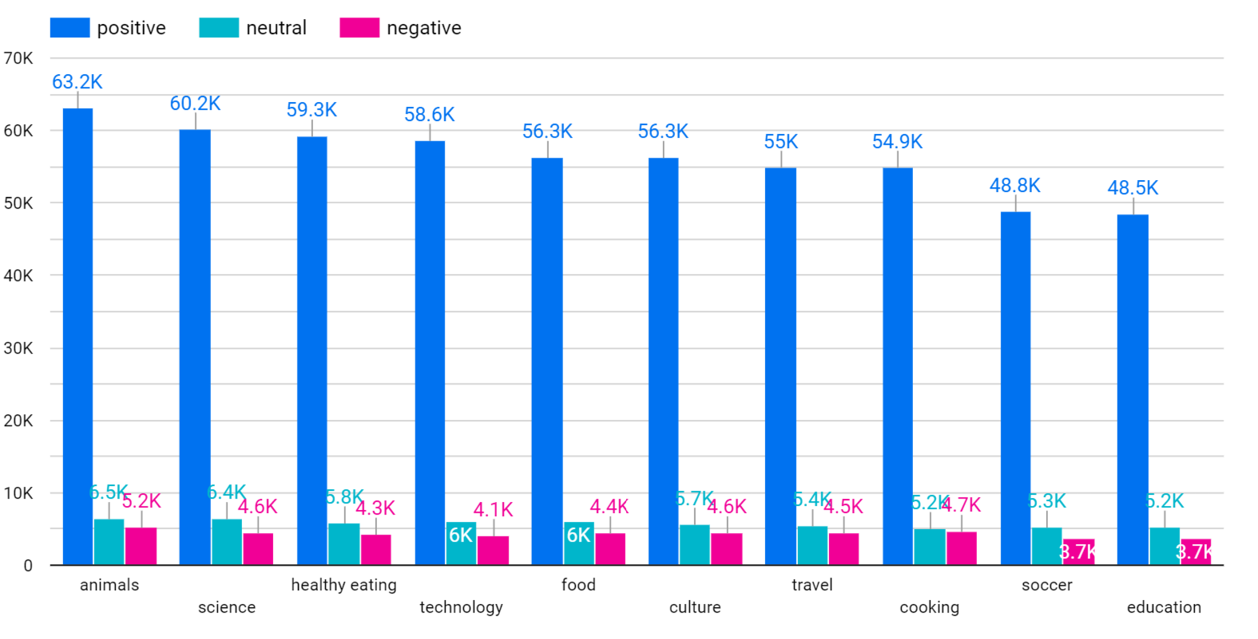
The highest content category with high negative sentiment is animals, although other categories have similar numbers, indicating that negative emotion is still high.

Slide 12

Analysis
Animals and science category are the most popular content, showing that people enjoy real-life and factual content the most
Insight
- Food categories is the common in 5 categories, there is also healthy eating that is similar with food. You could use this insight and working with healthy eating brands to boost user engagement.
- Each category has a particular content kind that performs well. We must concentrate on negative sentiment and determine what types of content cause negative emotion.
Summary
Next Step
This ad hoc analysis is insightful, but it’s time to take this analysis into large scale production for real time understanding of your business. We can show you how to do this.

Slide 13
Thank you!
ANY QUESTIONS?

